Slide 1
Capital Bikeshare Trip Data Analysis
Joel Bravo
Stephanie Gardner
Christopher Maerzluft
Bridget Morales
Suzy Park

Slide 2
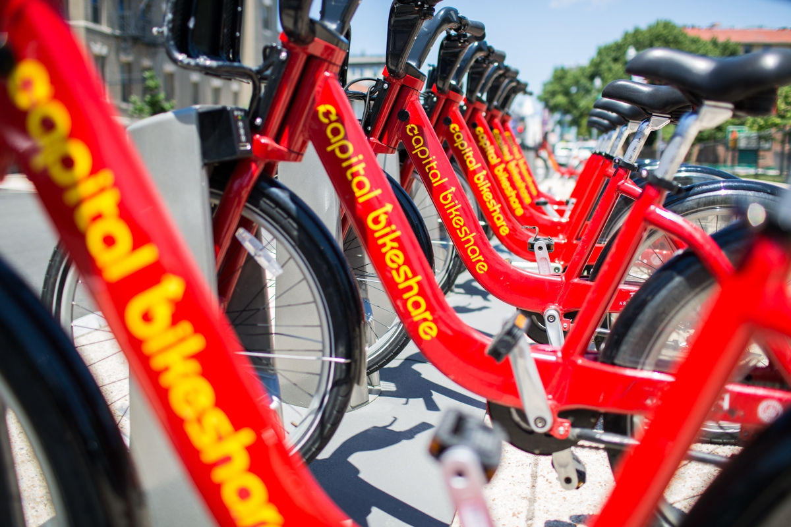
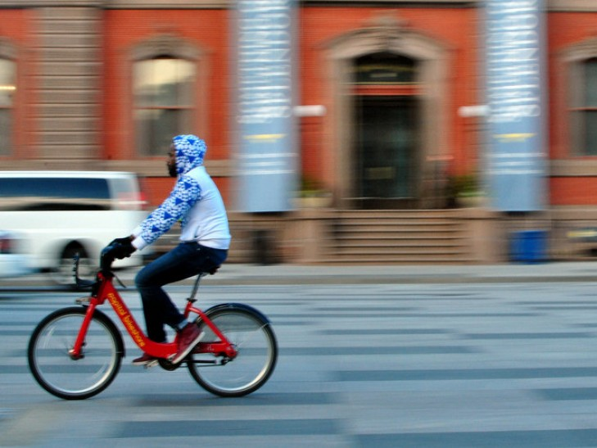
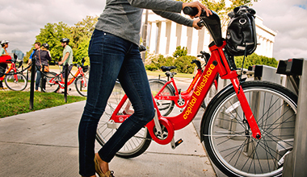
Capital Bikeshare Overview
rent
Capital Bikeshare is metro DC’s primary bikeshare system
More than 4,300 bikes and 500 stations
Multiple ways to ride
Single pass
24-hour pass
Annual membership
24/7, 365 days
Work commutes, running errands, and sightseeing
ride
return
Notes:
Once purchased, a customer can find a bike at a nearby station and unlock it with either a code (basic passes) or their bike key (annual subscribers).
Once their trip is concluded, customers dock their bikes at a station.

Slide 3
Capital Bikeshare Dataset
Timeframe
Two-year historical log from January 2011 - December 2012
Area Covered
Washington D.C. metro area
Including Arlington, VA, Alexandria, VA, and other neighboring counties in VA and MD
Data Batch Aggregation
Hourly basis
Records: 17,379 hours
Daily basis
Records: 731 days
Data Fields
Rental date
Season, year, month, day of the week, holiday
Climate-related data
Weather conditions, temperature, humidity, wind
Membership type
Registered member or “casual” rider

Slide 4
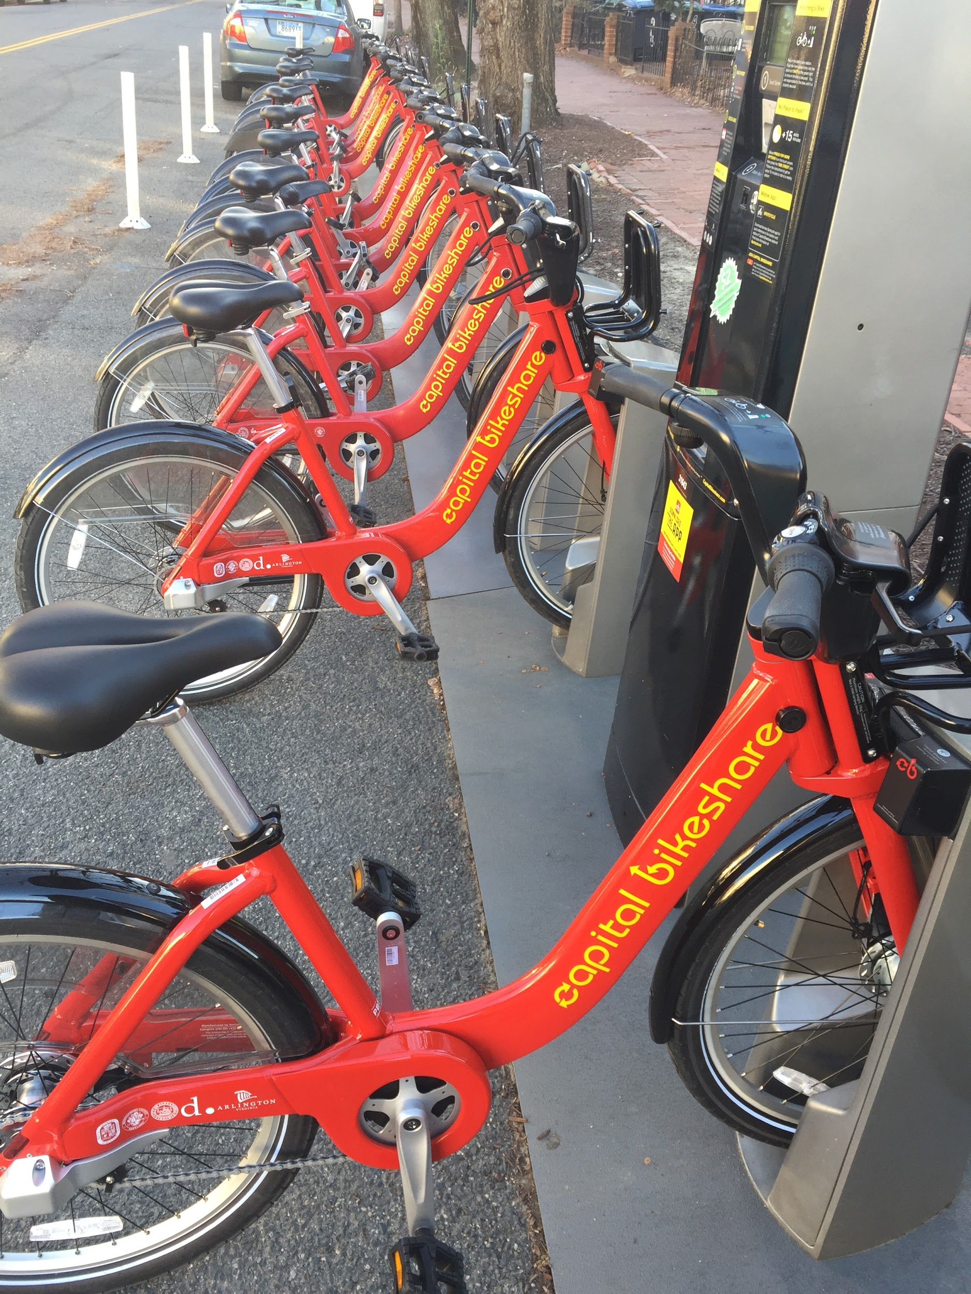
Bikesharing Business Questions
Objective: By understanding bikeshare usage, help the managing company Motivate to improve user experience, process efficiency, performance optimization, and remain competitive in the (shared) mobility market
When is the daily peak usage?
What is the pattern of usage weekly/monthly/seasonally?
What is the pattern of usage based on weather conditions?
What is the pattern of usage based on user’s membership type? (e.g. Who impacts bigger impact on the usage? Commuters or tourists?)

Slide 5
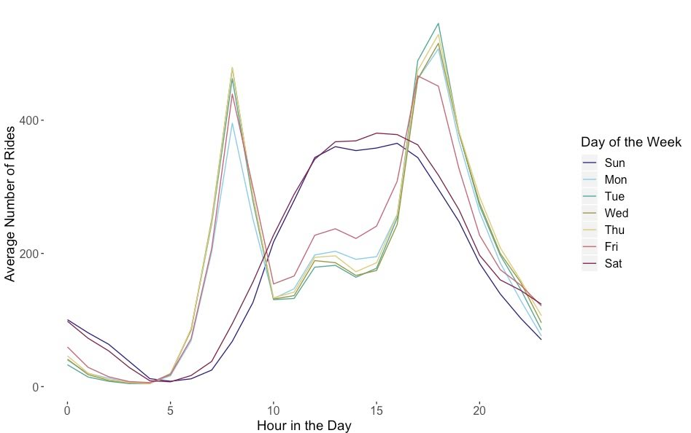
Daily Peak Usage
Weekdays
Usage peaks roughly match typical work commute
High peaks at 9am and 5pm
Weekends
Steady usage 1pm -4pm

Slide 6
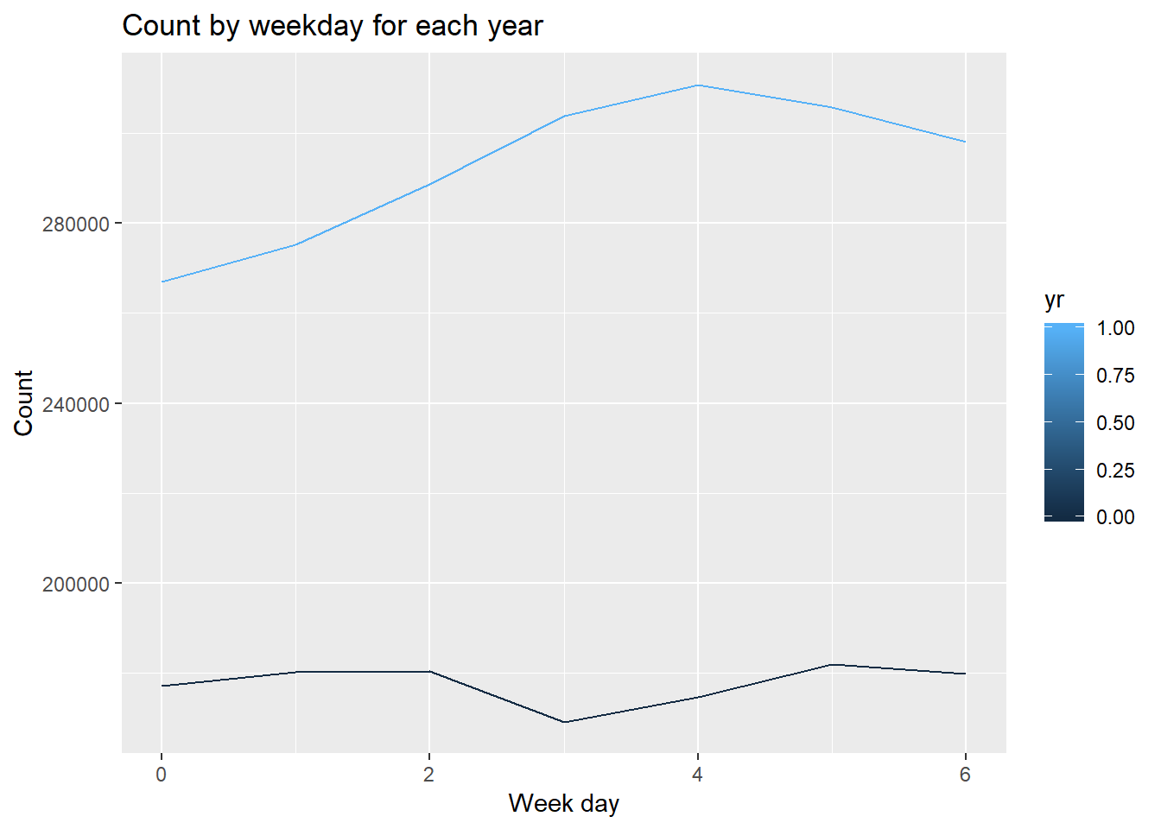
Weekly Bike Rental Patterns
Over the 2 year period we see a shift in the day of the week usage
2011
Decline on Thursdays
Steady usage on Tuesdays, Wednesdays, Saturdays
2012
Peak on Fridays

Slide 7
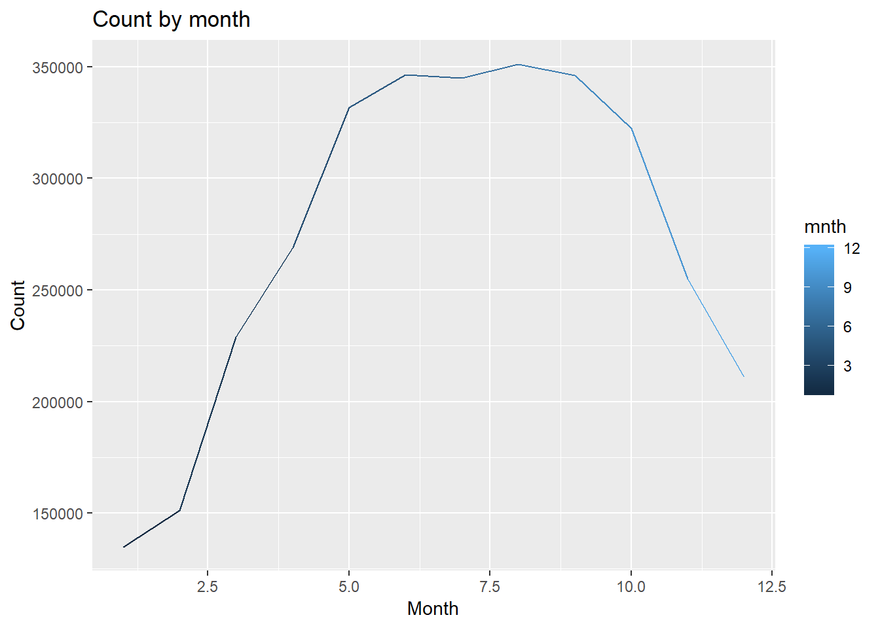
Monthly Bike Rental Patterns
High usage: Summer - Early Fall
Peak usage in August
Decline begins in October
Low usage: Winter
Low usage: January - weather conditions

Slide 8
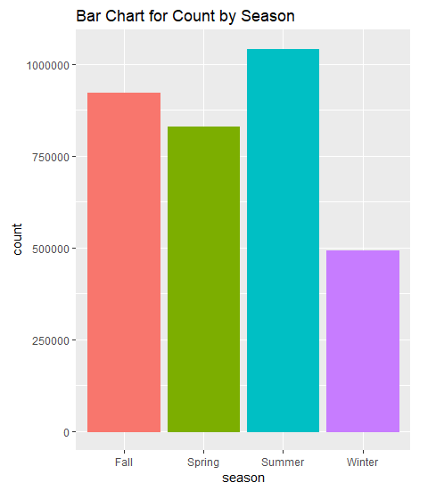
Seasonal Bike Rental Patterns
Summer and Fall see the highest number of bike rentals
Severe drop off of rentals in Winter
Confirms trends seen in monthly rental visualization seen previously

Slide 9
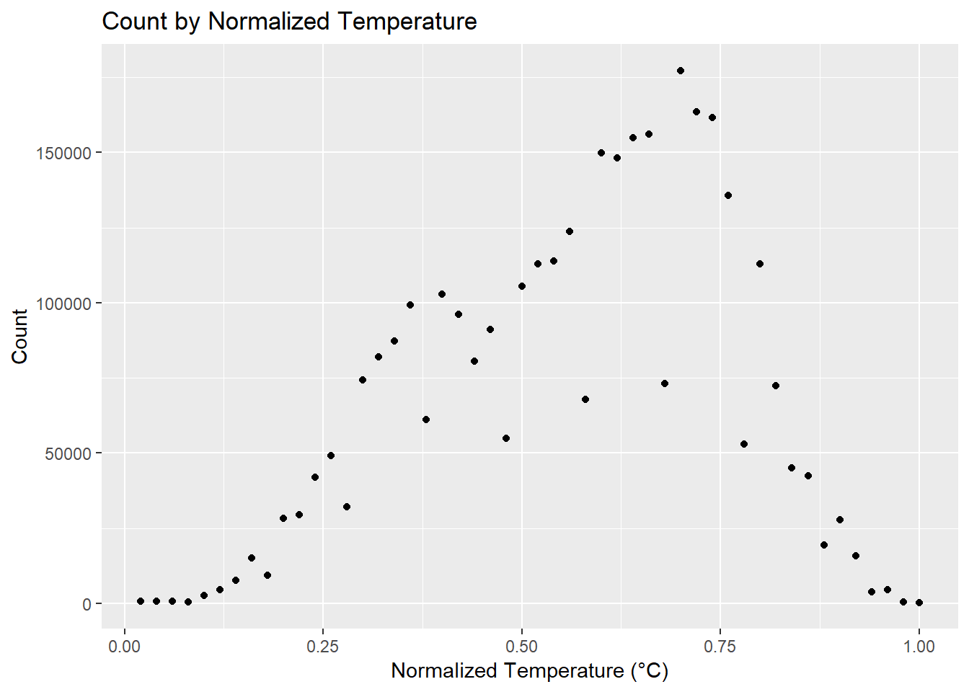
Weather Conditions Patterns - Temperature
Generally, as temperature increases there is a steady increase in the number of rides
Past a certain point in temperature, the number of rides drops significantly due to heat

Slide 10
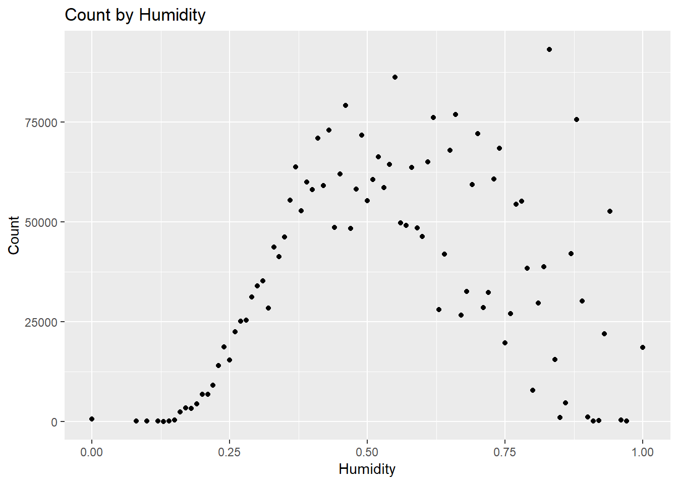
Weather Conditions Patterns - Humidity
Fairly normal distribution with a few outliers
Outliers can be assumed to be in the peak summer months with high usage
Usage decreases with the increase of humidity which can also be assumed with high temperature

Slide 11
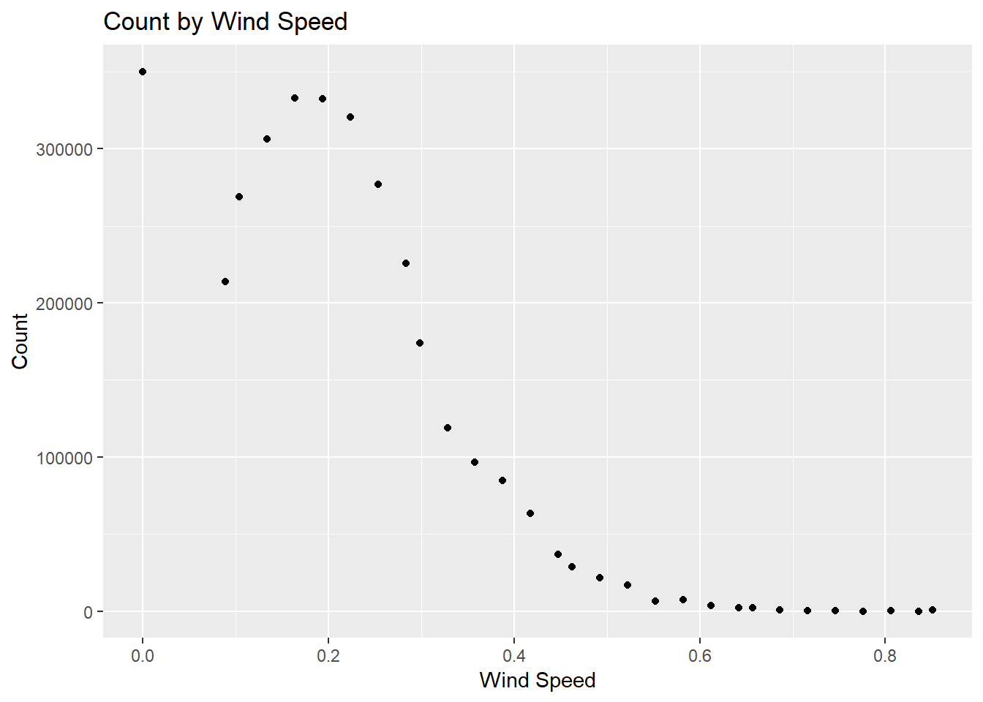
Weather Conditions Patterns - Wind Speed
While there is a small increase in rides as the wind speed initially increases, it is followed by a sharp decrease
Right skewed distribution
People generally don’t go out much with high winds

Slide 12
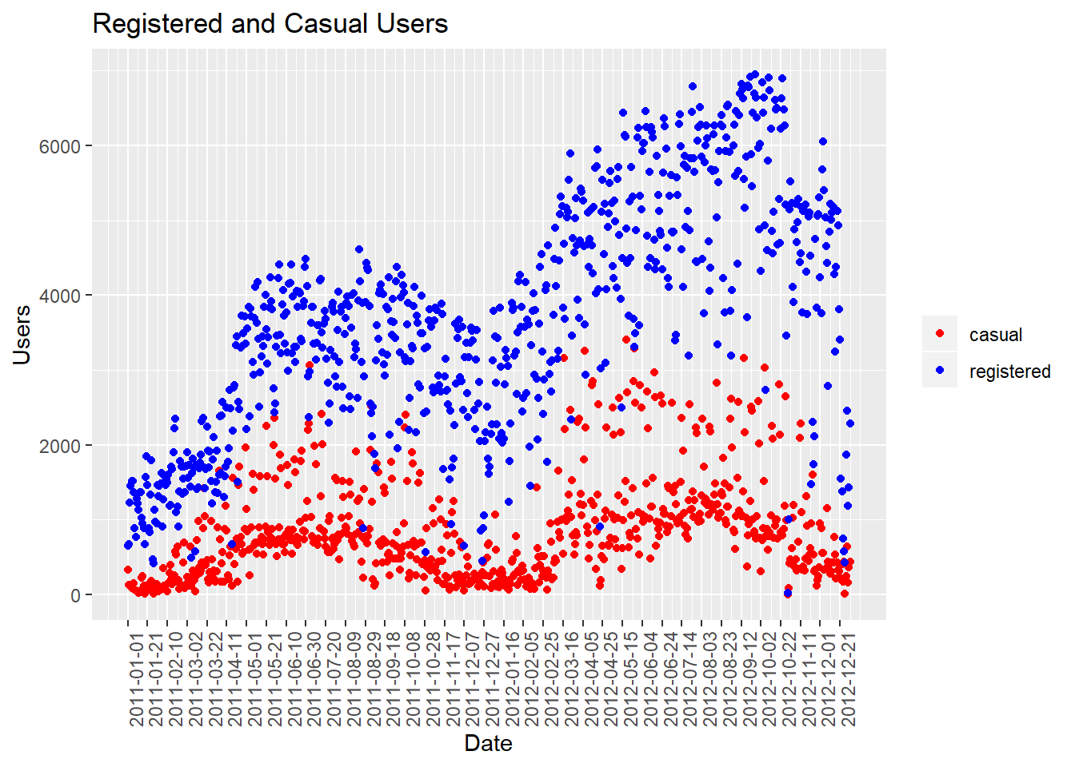
Membership Type Patterns
Registered members have significantly higher usage than casual riders
Casual riders see a regular increase during the spring and summer months over 2 years (tourists, more pleasant weather)
Registered riders follow a similar pattern

Slide 13
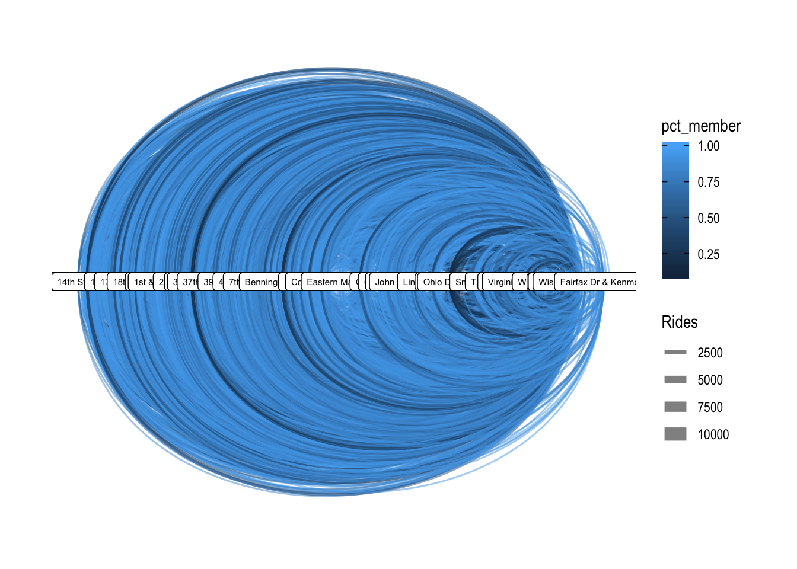
Routes
Very small set of routes that have a high usage rate

Slide 14
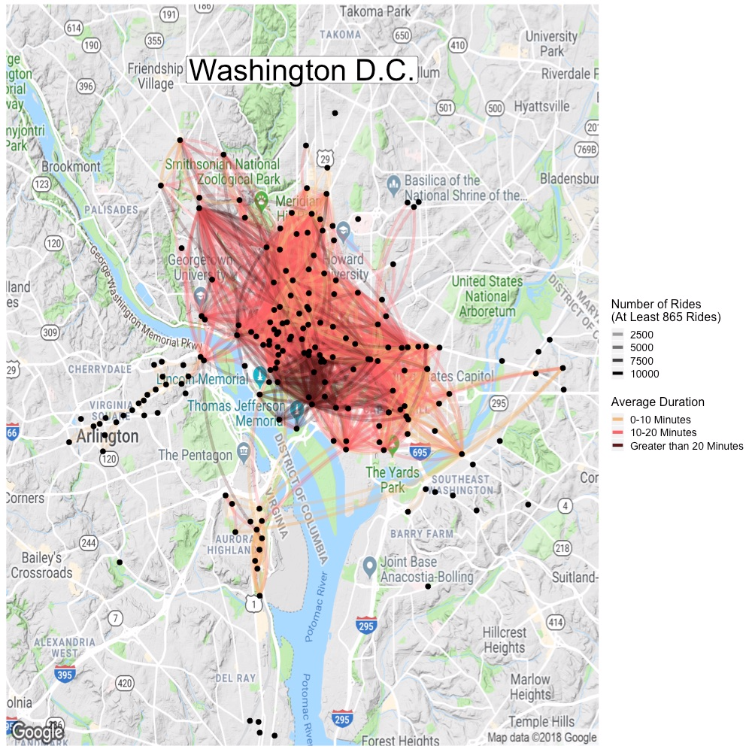
Average Duration
Top 90th percentile of rides from a route.
Noticeably large cluster of short rides of high duration (greater than 20 minutes) near center of DC
Cluster of similar duration near the northwest section of DC
What is causing this?

Slide 15
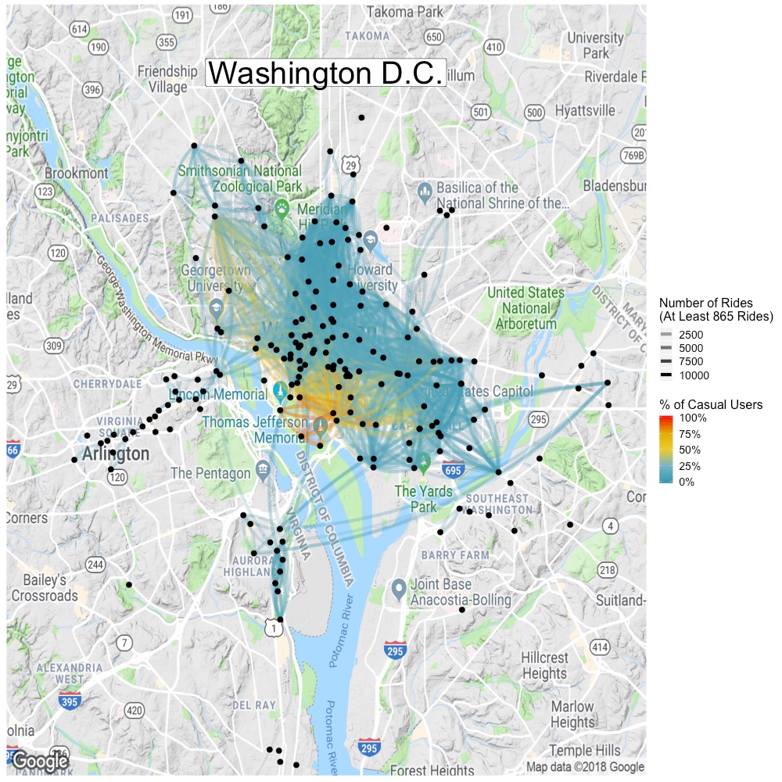
No. of Rides By Casual Users
Noticeable cluster of rides in the center of DC dominated by high number (>7500) of casual users (>75%)
Rides are noticeably short compared to longer length rides across the region
High number of attractions and monuments
Tourists primary driver of rides in center of DC

Slide 16
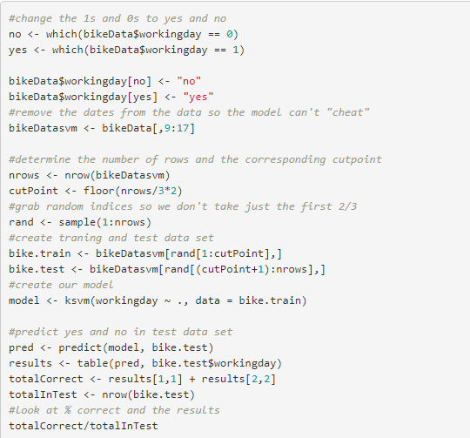
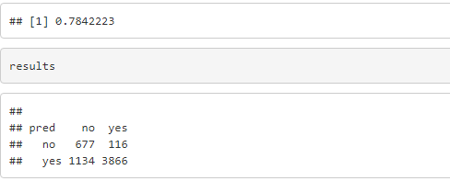
Machine Learning
Can we predict if the day the bike was rented was a weekday?

Slide 17
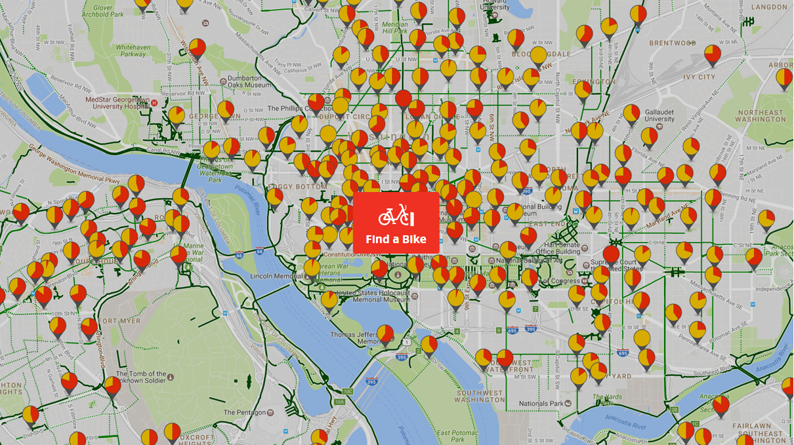
Additional Questions
What other predictive analysis can be achieved on future usage?
Based on historical data, what else can be automated?
How has trends/patterns been affected with introduction of competition, such as dockless scooter sharing?
What other external events/variables can have significant impact? (e.g. metro closures, government activities including shutdown, events in the national mall)

Slide 18
Application of Findings
Casual riders can be a lucrative source of revenue during the late Spring - early Fall months
Look into promotions to encourage greater use in tourist locations
Partnerships with tourist spots to attract more riders (e.g., guided bike tours)
A very small set of routes account for the majority of the rides
Look into expanding the number of available bikes for those routes to maximize the amount of rides
Use daily rental patterns to identify peak days and expand number of bikes in high ride routes
Colder months see a general downturn in bike usage
Ideal time to upgrade bike fleet/perform maintenance without impacting ride volume

Slide 19
Analysis of bike data is meaningless without proper application

Slide 20
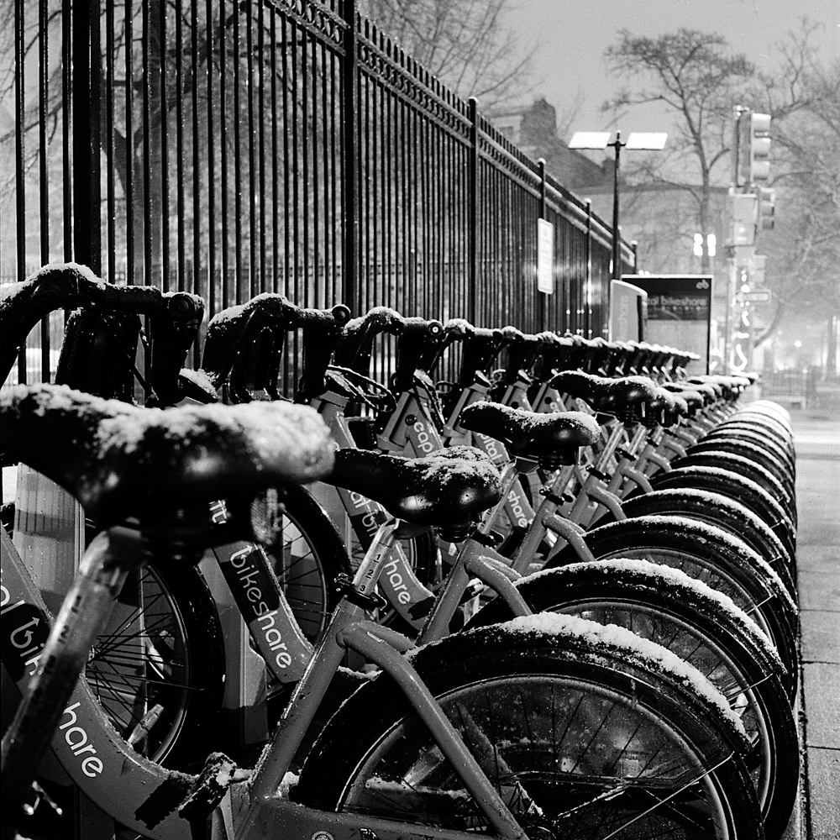
Thanks!

